Slide 1



TP1 :Practical comparative structural modeling Case study : α-amylase from Alteromonas haloplanktis
Objectif : generate theoretical models of protein structure using a homologous protein structure
Manel Ben Dassi
Master 1 in Bioinformatics
2023/2024

Slide 2
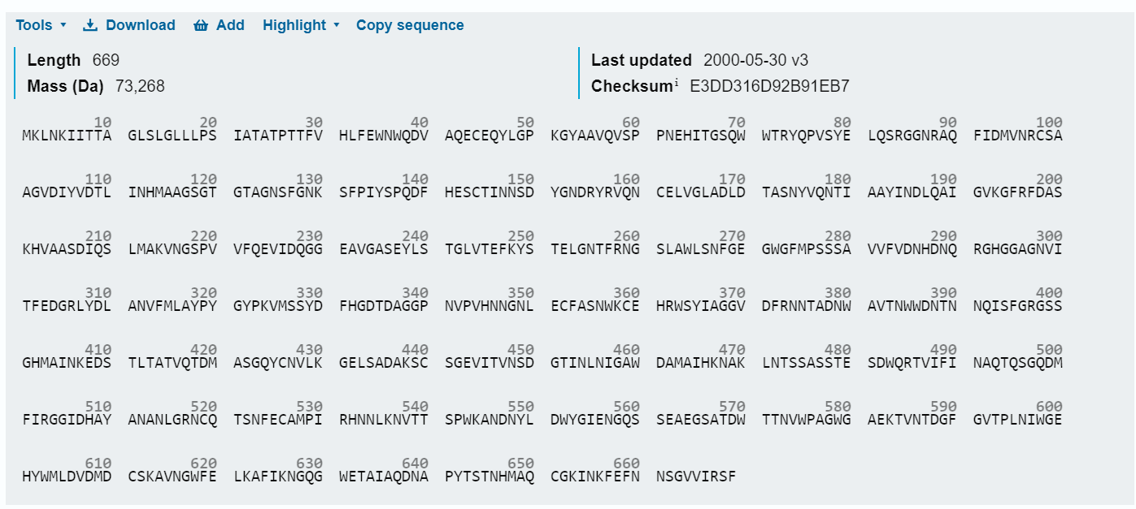
Step1: Identification and Selection of Template structure
Get access to Uniprot database (http://www.uniprot. org/) to get the protein sequence of AA (Target Sequence)
PDB code: 1AQM
Download the sequence in fasta format

Slide 3
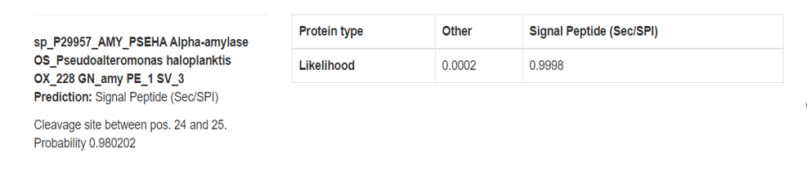
Elimination of the initiating sequence
Tool used: Signa lP - 6.0
Searching for template : homologous protein to the target sequence
Tool used: Basic Local Alignment Search Tool (BLAST)
in this case we use Blast to identify sequences in different species that are similar or homologous to our target
sequence
Parameters used:
Databases : Standard databases
Database : Protein Data Bank proteins (pdb)
Algorithm: blastp (protein-protein BLAST)

Slide 4
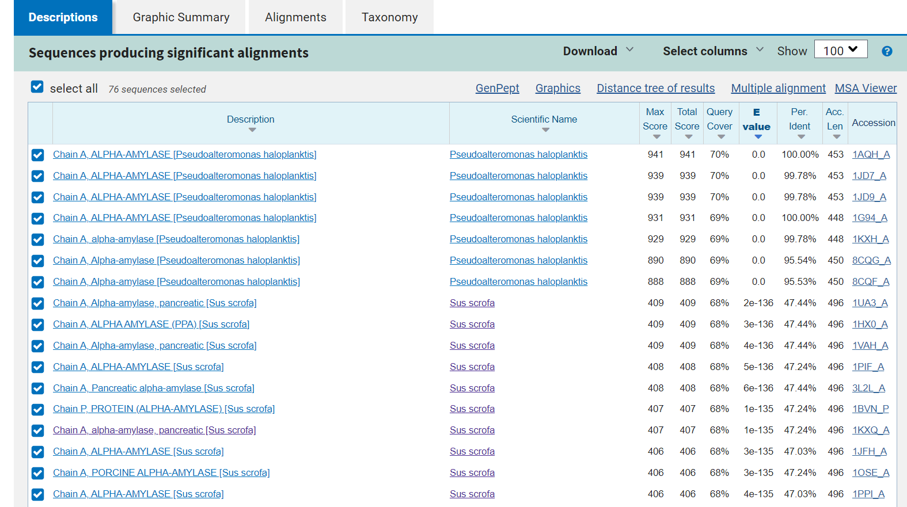
Blast result :
Template sequence selection
various factors are considered in choosing an eligible template:

Slide 5
Sequence similarity level of the template sequence in relative to the target sequence : >25% , this will increase the accuracy of the model being generated
Sequence identity level: is defined as the percentage of residues of the two aligned proteins that are identical, there are three levels by which sequence identity can be categorized: low, intermediate and high levels of sequence identity. However, the intermediate levels of sequence identity, between the two aligned proteins is 25% 90%.
Query Coverage: refers to the fraction of a query sequence that is aligned to a database sequence in a sequence alignment. It represents the percentage of the query sequence that is covered by the alignment with the database sequence. A higher query cover indicates a more complete alignment between the query and database sequences.
E-Value: the number of alignments expected by chance with the calculated score or better. The expect value is the default sorting metric; for significant alignments the E value should be very close to zero.
Template quality: the template should has been experimentally determined and has a high resolution, resolution should be between 1A to 3A.
Conserved regions: choose the template with conserved regions that align well with the target protein sequence. This will help ensure that the model accurately captures the structural features of the protein
Phylogenetic similarity between template and target sequences
Environmental factors such as pH, solvent type and existence of bound ligand…

Slide 6
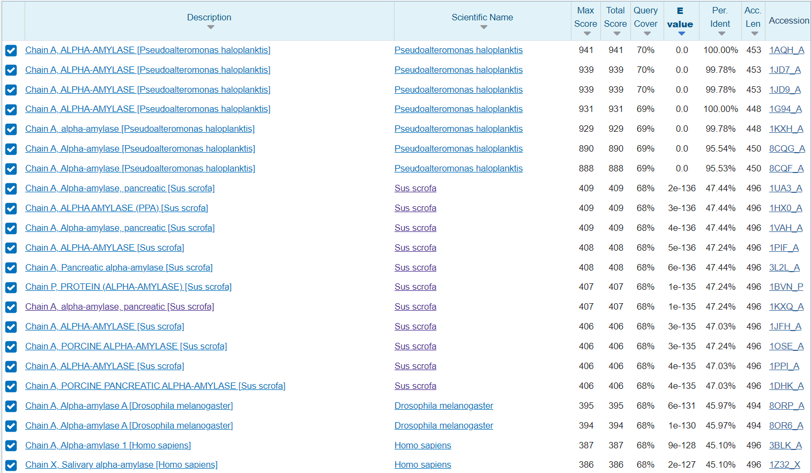
The template was chosen based on the prameters mentioned before
PDB code: 1KXQ
characteristic of the chosen template:
E-value: 1e -135
Coverage: 66%
Identity: 47.24%
resolution: 1.6A
Organism: Sus scrofa (pig)
Eukaryota

Slide 7
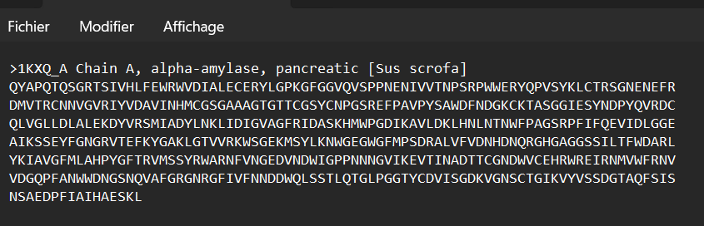
Download the template sequence in fasta format
Step 2: Pairwise alignment between the target and the template sequences
Tool used: EMBOSS Needle
Pairwise alignment is done in order to determine the level of similarity between the two sequences, by aligning the sequences, we can identify regions of high sequence identity and similarity, which can indicate conserved structural elements and functional domains. This information can then be used to guide the modeling of the target protein's 3D structure based on the template structure.
pairwise alignment can help identify potential errors or gaps in the alignment, which may need to be addressed to improve the accuracy of the predicted 3D structure.

Slide 8
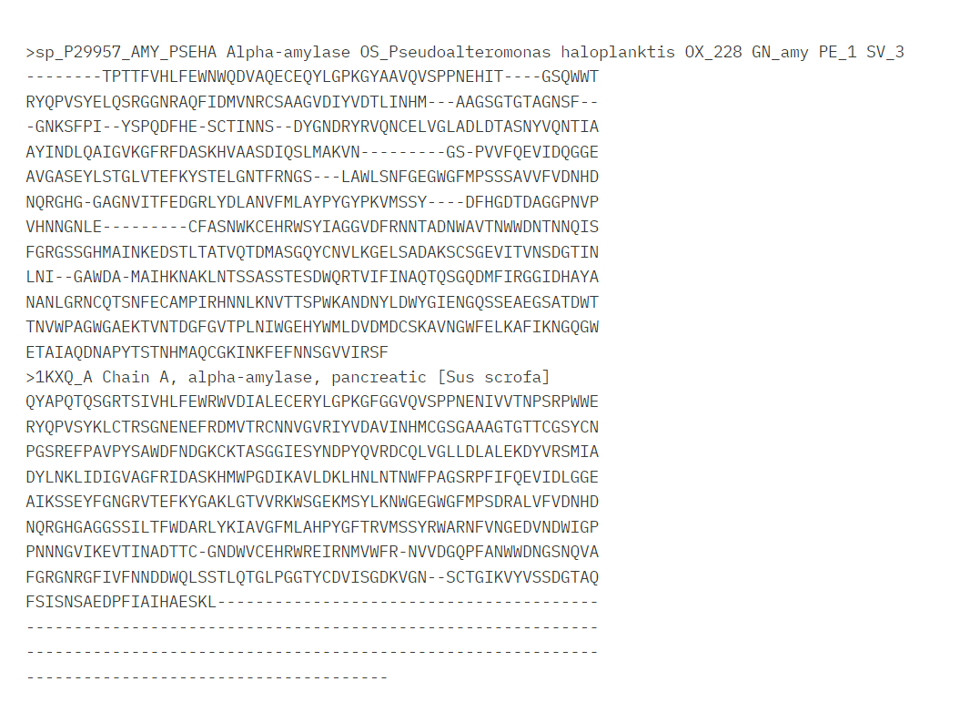
EMBOSS Needle result :

Slide 9
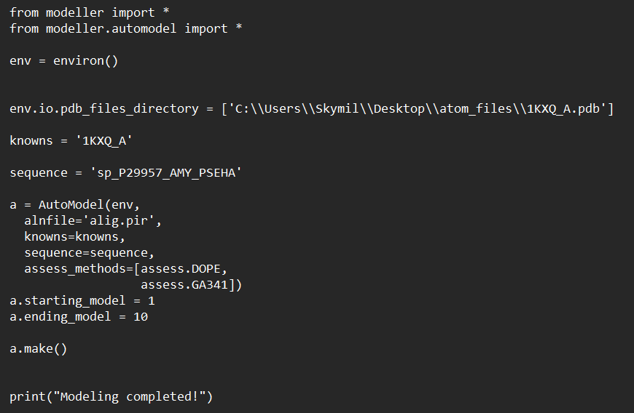
Step 3: Building the homology model
Tool used :Modeller
Download the 3D structure of the template sequence from PDB
Creating the input file:
PDB file for 3D structures of the template: water molecules are manually removed
Script :

Slide 10
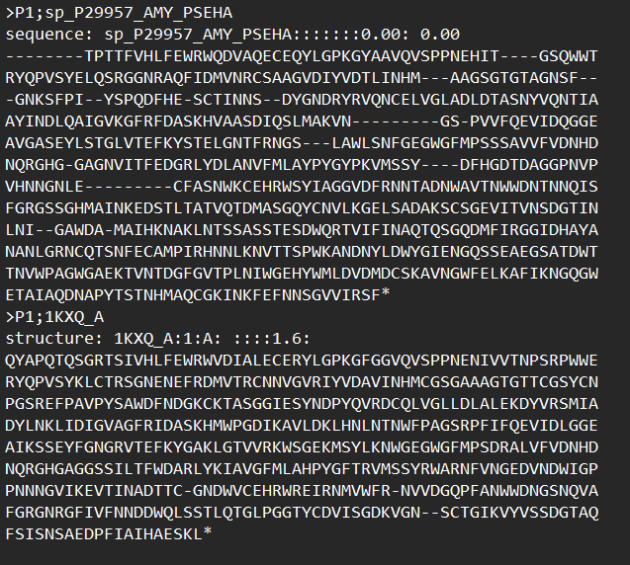
Alignment file: pir format
The fasta file alignment extension is converted to the pir extension manually

Slide 11
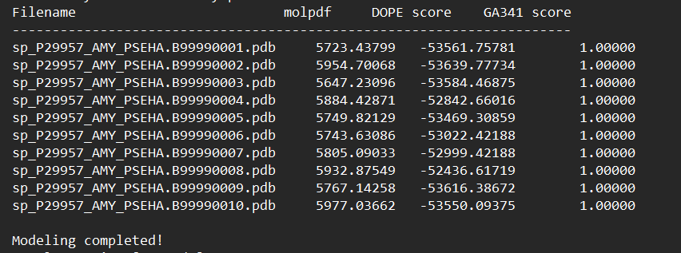
Execute the script by using the command mod 10.5 script name.py
Out put of the modeller :
34 elements :
Ten 3D structures models (.pdb file)
One file contains a summary of models that have been successfully produced (.log file )
Ten file contains conjugate gradients optimization of each structure model
One file contains configuration settings (.ini)
One file (.rsr)
One file (.sch)
Ten file contain heavy relative violations of each residue of each generated structure

Slide 12
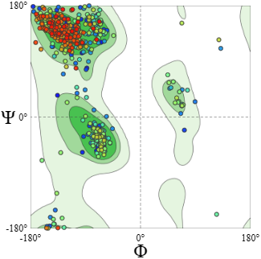
Step 4 :Quality assessment of the homology model
Selection of the best model:
The selection is made according to the DOPE and GA341 scores
Lowest DOPE score: -53639.77734
Highest GA341 score: 1
Beta-sheet
Left
handed
alpha-helix
Evaluation of the model's quality
1st tool :Ramachandran plots to check the stereochemical quality
Phi (φ) and Psi (ψ) Angles: These angles represent the rotation around specific bonds in the protein backbone.
The Ramachandran plot depicts the allowed regions for these angles, which correspond to sterically unhindered and energetically stable protein conformations.
Right handed
alpha-helix
Ramachandran plots for the chosen structure

Slide 13
MolProbity Results:
parameters | Score | analysis
MolProbity Score | 2.96 | This value indicates the overall quality of the protein structure. A lower MolProbity score typically suggests a higher quality structure.
Clash Score | 63.13 | indicates the number of steric clashes within the structure. Lower clash scores are preferred as they indicate better packing of atoms within the structure.
Ramachandran Favoured | 93.78% | this value indicates the percentage of amino acid residues in the protein that have phi-psi angles within the allowed regions of the Ramachandran plot. It indicating a well-folded protein structure.
Ramachandran Outliers | 1.40% | This value represents the percentage of residues with phi-psi angles outside the allowed regions, which is relatively low and suggests a good quality structure
Rotamer Outliers | 2.28% | this value represents the percentage of amino acid side in unusual conformations. Outliers here could suggest issues in the side chain packing or potential errors in the model.
C-Beta Deviations | 7 | 7 residues have significant deviations in their side chain torsion angles. These deviations could be caused by an incompatibility between the side chain and backbone conformation
Bad Bonds | 17 / 5131 | 17 out of 5131 bonds in the protein structure have lengths outside the expected range
Bad Angles | 144 / 6989 | 144 out of 6989 angles in the protein structure have values outside the expected range
Overall Analysis:
While the Ramachandran plot analysis suggests a good quality structure (with over 93% of residues in allowed regions and low outlier percentages ), the presence of C-Beta deviations, bad bonds, and bad angles indicates some potential issues that could be addressed to improve the overall quality of the structure.

Slide 14
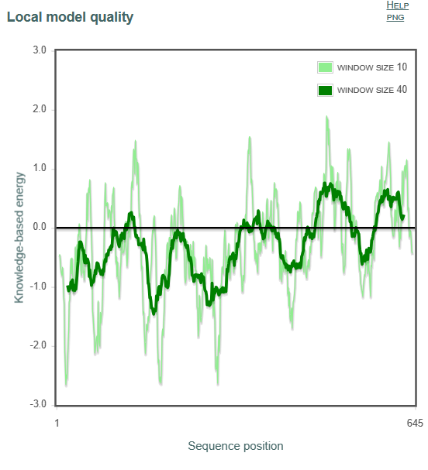
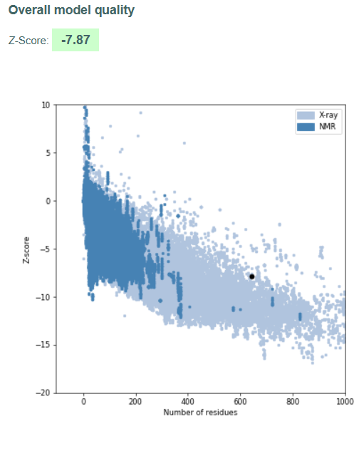
2nd tool : Prosa to check the local quality of the model
Prosa Results:
This plot of local model quality, shows the energy of each amino acid residue in the protein chain is plotted along the x-axis according to its position (i) in the sequence.
Lower energy scores typically indicate more favorable and stable conformations for the residue.
Higher scores suggest less favorable interactions or potential strain.
Window size refers to the number of amino acids that are considered together when calculating the local model quality. The smoother the curve, the better the local model quality is predicted to be.
The theoretical model's Z-score value is similar
to the Z-score of the experimental structure solved
by X-rays.

Slide 15
Step 5: Alignment of the 3D model selected with the experimentally solved structure (1AQM)
Tool used: Pymol (to compare two structures)
Method : Root Mean Square Deviation (RMSD)
The RMSD value should be the average of the root mean square deviations between the observed values and the predicted values. A lower RMSD value, means a more accurate prediction model. In general, an RMSD value less than 1 is considered good, but this can differ depending on the modeling context.
MatchAlign: aligning residues (645 vs 449) This section reports the results of the initial alignment process MatchAlign: score 2421.000
ExecutiveAlign: 448 atoms aligned. This section refers to a further refinement step in the alignment process
ExecutiveRMS: 29 atoms rejected during cycle 1 (RMSD=3.13). ExecutiveRMS: 30 atoms rejected during cycle 2 (RMSD=1.53). ExecutiveRMS: 16 atoms rejected during cycle 3 (RMSD=1.00). ExecutiveRMS: 13 atoms rejected during cycle 4 (RMSD=0.86). ExecutiveRMS: 11 atoms rejected during cycle 5 (RMSD=0.80).
Executive: RMSD = 0.755 (349 to 349 atoms)
Pymol results:
This section shows the root-mean-square deviation (RMSD) between the aligned structures. The results show multiple cycles of refinement, with a gradual decrease in RMSD in each cycle
The last line states the final RMSD after the refinement cycles. This indicates a good alignment between the two structures, with an average difference of 0.755 Ångströms between the aligned atoms.

Slide 16
Overall, the alignment results suggest a good match between the 3D model and the experimentally solved structure. The high score and low RMSD values indicate a high degree of similarity between the two structures.
This shows how accurate it is the theoretical structure compared to the experimentally determined structure, this can solve the problem of the gap between the number of discovered sequences and the number of 3D structures.
Adopting the theoretical method can save time, money, and produce high quality results.
Step 5: Alignment of the template (1KXQ) with the experimentally solved structure (1AQM)
Pymol results:
MatchAlign: aligning residues (2468 vs 449) MatchAlign: score 1109.000 ExecutiveAlign: 441 atoms aligned. ExecutiveRMS: 32 atoms rejected during cycle 1 (RMSD=3.48). ExecutiveRMS: 36 atoms rejected during cycle 2 (RMSD=1.58). ExecutiveRMS: 19 atoms rejected during cycle 3 (RMSD=0.87). ExecutiveRMS: 18 atoms rejected during cycle 4 (RMSD=0.71). ExecutiveRMS: 14 atoms rejected during cycle 5 (RMSD=0.63). Executive: RMSD = 0.578 (322 to 322 atoms)
The result of align shows that the two protein structures are very similar, with a high MatchAlign score and a low RMSD value

Slide 17
the answer of this question will be based on two point
The question that arises is why the model, template, and crystallographic structure are so closely correlated, even though they come from two completely different species ?
Temlate from Sus scrofa (mammal)
Crystallo structure from Alteromonas haloplanktis (bacteria)
The answer to this question will be based on two concepts:
Evolutionary Conservation: even though pigs and bacteria are distantly related organisms, some proteins may share similar structures and functions because they evolved from a common ancestor but diverging significantly over time.
These conserved proteins might play essential roles in basic biological processes that are necessary for all life forms.
Convergent Evolution : the proteins might have evolved independently to perform similar functions and converged on similar structures despite having different sequences.
Based on the two concepts, it is possible to suggest that this protein structure (α-amylase ) is likely crucial for its function and has been conserved throughout evolution or has converged due to functional pressure.
In summary, the high degree of consistency between structures from completely different species can be contributed to the power of structural conservation and convergence in protein evolution.

Slide 18
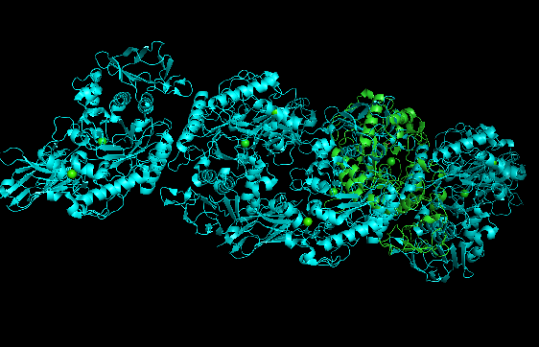
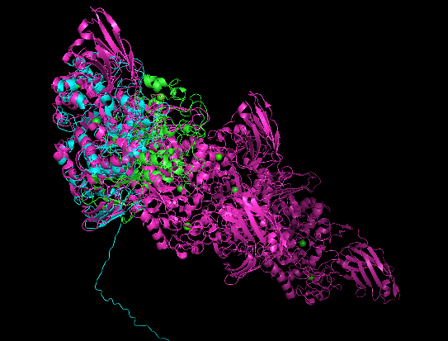
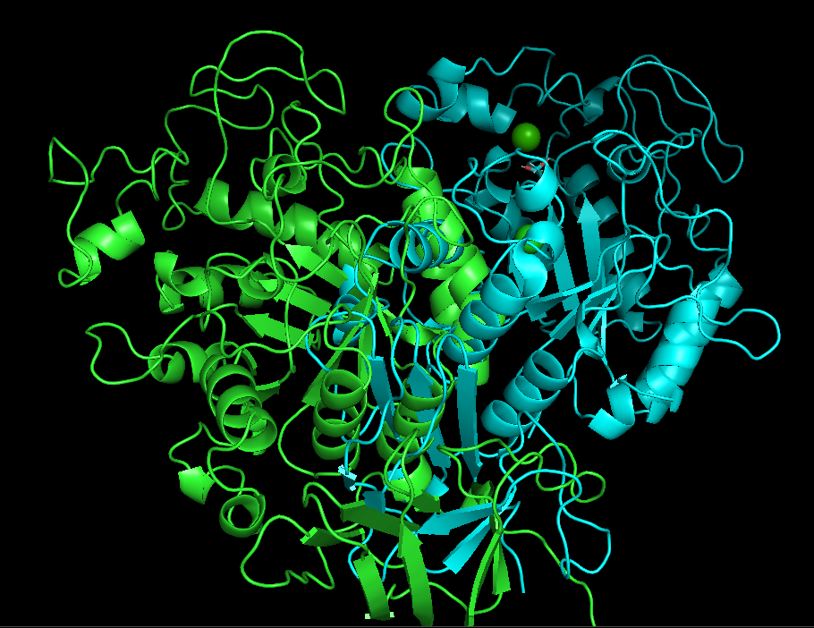
1AQM
1KXQ
Model
1AQM
1KXQ
1AQM
Model

